Slide 1

Room Management Appliance
Shoumen Mondal
ID: 151-35-853
Sec:B
Department of software engineering
12/12/2017
1

Slide 2
Room Management Appliance
Introduction:
A system for managing shared office, meeting, laboratory, and teaching space is to be developed. A networked display appliance is situated outside each room. The appliance indicates who has reserved the space and for what period. The appliance allows users to reserve a room and check the availability of other rooms.
12/12/2017
2

Slide 3
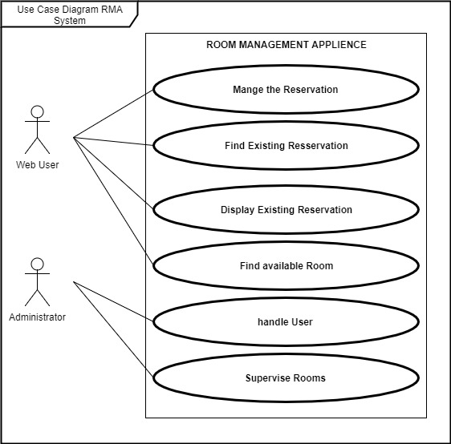
Room Management Appliance
12/12/2017
3

Slide 4
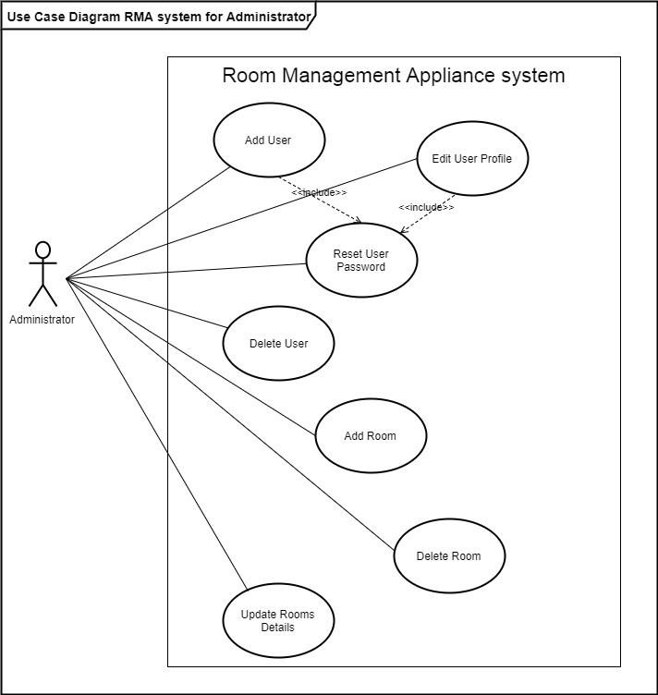
Room Management Appliance
12/12/2017
4

Slide 5
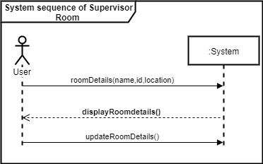
Room Management Appliance
12/12/2017
5

Slide 6
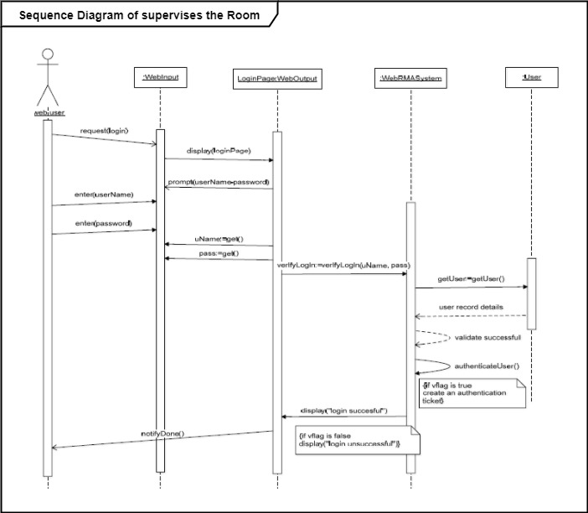
Room Management Appliance
12/12/2017
6

Slide 7
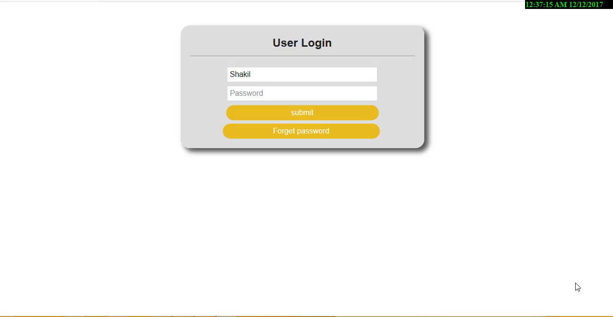
Room Management Appliance
Project Review By Video
12/12/2017
7

Slide 8
Thank you all
12/12/2017
7

